Slide 1



Problems Definition
Optimization Algorithm
Optimization Results
Francisco Stigliano & Edoardo Palmisciano

Slide 2
Optimization of Cooling Tower Design for Minimized Return on Investment Time
Problem Definition
Francisco Stigliano & Edoardo Palmisciano

Slide 3
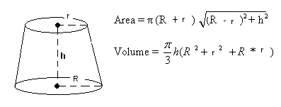
Minimizing Return on Investment Time
Geometry
- The tower is a frustum (a truncated cone).
D1 = 60 + 0.4 * h; → diameter at the bottom
D2 = 40 + 0.2 * h → diameter at the top
Decision Variable: Cooling tower height (h) in meters , h $h∈[100,200]$

Slide 4
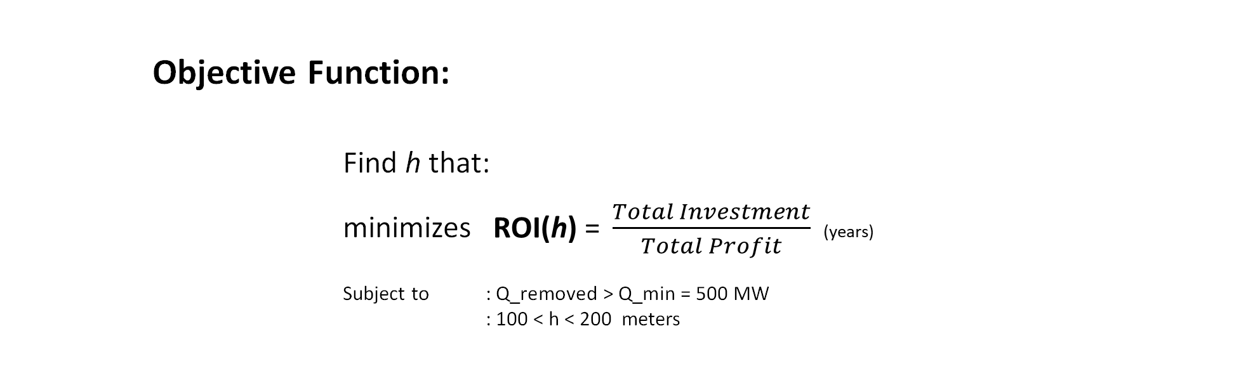
Minimizing Return on Investment Time
Formulation
Objective Function:
Find h that:
minimizes $\text{ROI}\text{(}\text{h}\text{)} \text{= }\frac{Total Investment}{Total Profit}$(years)
Subject to : $\text{Q}\text{_}\text{removed} \text{> }\text{Q}\text{_}\text{min}$ = 500 MW
: 100 < h < 200 meters

Slide 5
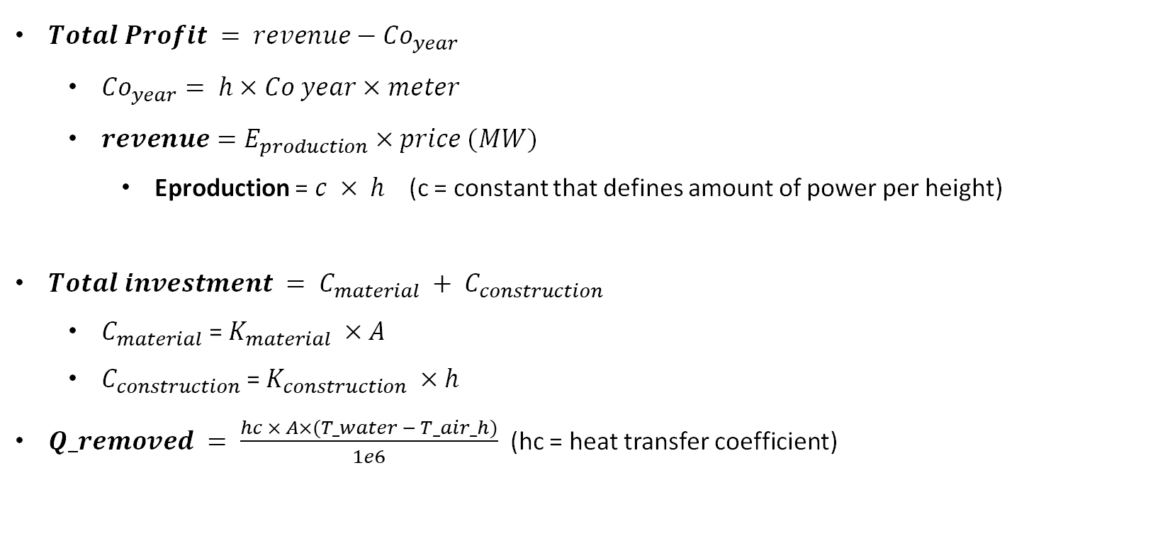
Minimizing Return on Investment Time
Functions
$Total Profit = revenue−{Co}_{year}$
${Co}_{year}= h×Co year×meter$
$revenue=E_{production}×price (MW)$
Eproduction =$c × h$(c = constant that defines amount of power per height)
$Total investment = C_{material} + C_{construction}$
$C_{material}$= $K_{material} ×A$
$C_{construction}$= $K_{construction} ×h$
$Q_removed = \frac{hc × A×(T_water − T_air_h)}{1e6}$ (hc = heat transfer coefficient)

Slide 6
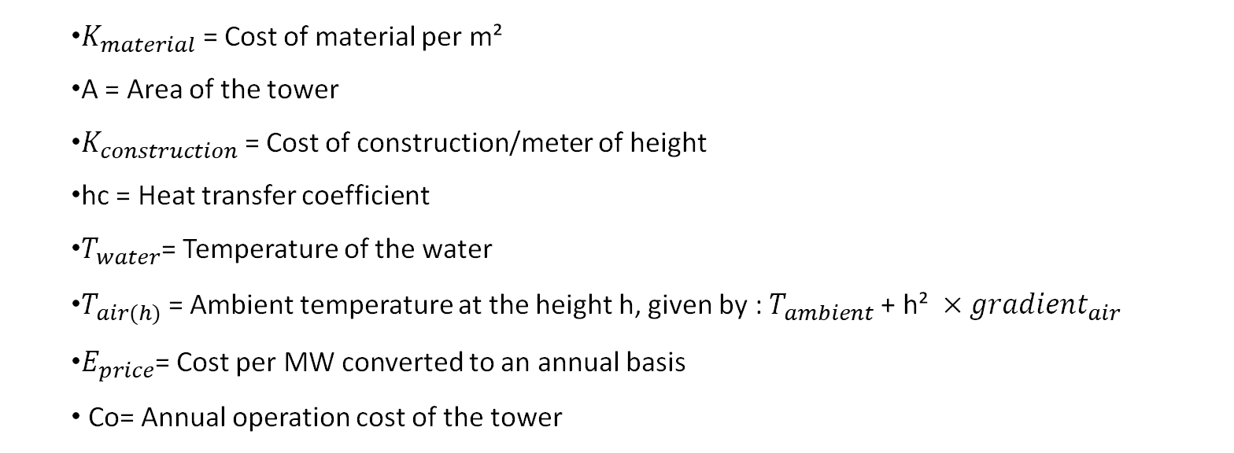
Minimizing Return on Investment Time
Definitions
Definitions:
$K_{material}$= Cost of material per m²
A = Area of the tower
$K_{construction}$= Cost of construction/meter of height
hc = Heat transfer coefficient
$T_{water}$= Temperature of the water
$T_{air(h)}$= Ambient temperature at the height h, given by : $T_{ambient}$+ h² $×{gradient}_{air}$
$E_{price}$= Cost per MW converted to an annual basis
Co= Annual operation cost of the tower

Slide 7
Optimization of Cooling Tower Design for Minimized Return on Investment Time
Sensitivity Analysis
Francisco Stigliano & Edoardo Palmisciano

Slide 8
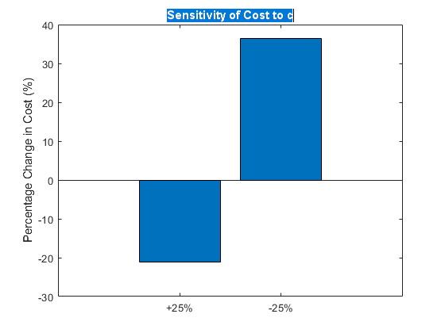
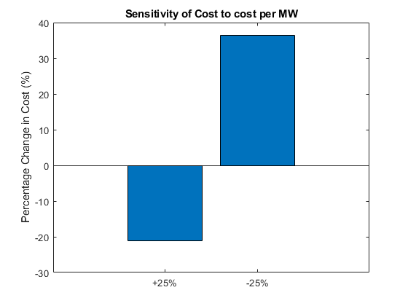
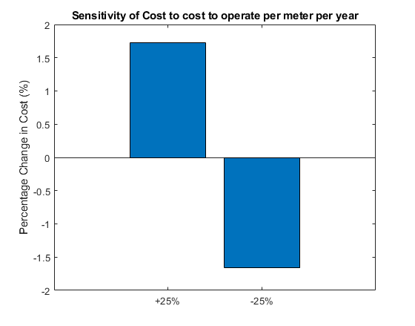
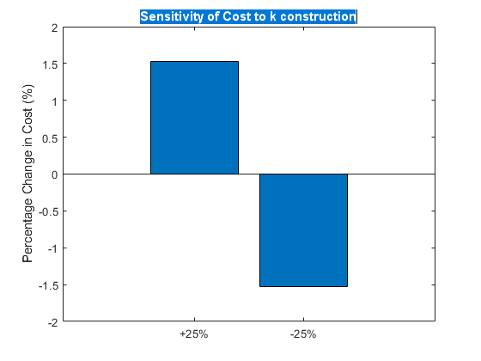
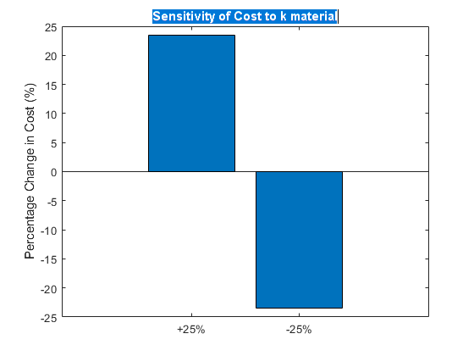
Minimizing Return on Investment Time
Sensitivity Analysis
Each parameter was individually varied by ±25% to analyze how this change influences the Objective Function behavior.

Slide 9
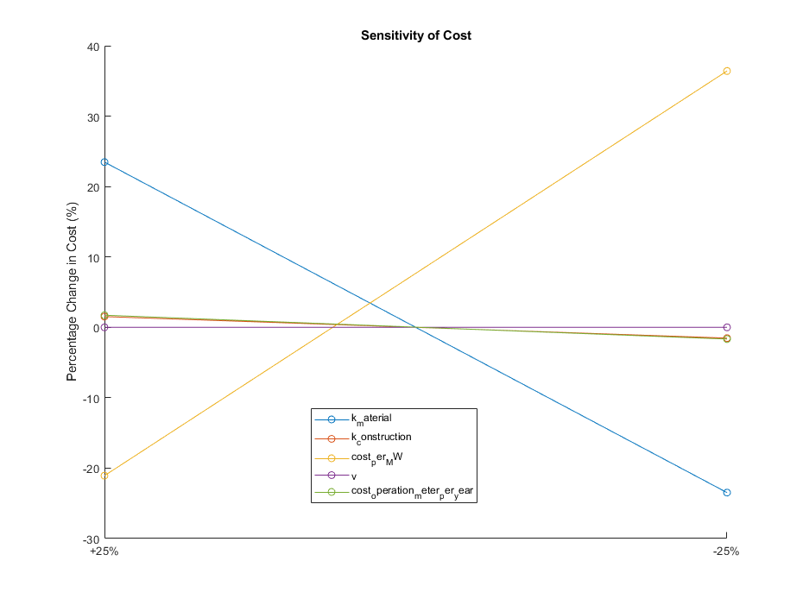
Minimizing Return on Investment Time
Sensitivity Analysis
Comparing the 5 parameters that influence the changes in the cost.

Slide 10
Minimization of time to accelerate from an initial to an end velocity
Problem Definition
Francisco Stigliano & Edoardo Palmisciano
Notes:
RGB 0 85 114

Slide 11
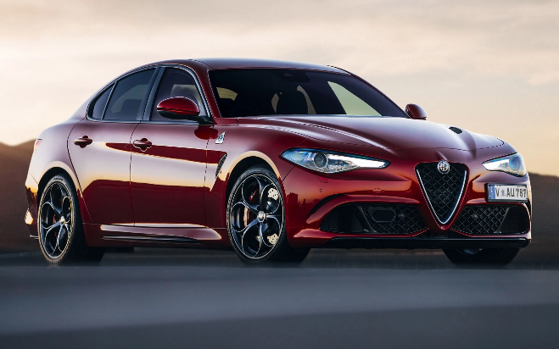
Vehicle Specifications
Alfa Romeo Giulia 2.9 V6
P A R A M E T E R S
Vehicle weight | 1650 kg
Transmission efficiency | 0.9
Tyres (Rear) | 285/30 R19
Maximum power | 500 HP
Top speed | 307 km/h
I Gear ratio | 0.247
VI Gear ratio | 1.147

Slide 12
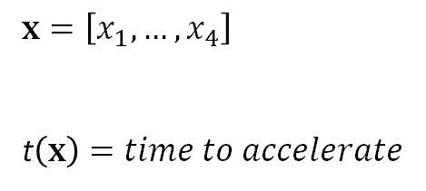

Optimization Problem
Definition
6-Speed Manual Tramission
G E A R R A T I O S
I | II | III | IV | V | VI
0.247 | ? | ? | ? | ? | 1.147
$$x$$
$$x=\left[x_{1},…,x_{4}\right]$$ t$\left(x\right)=time to accelerate$
Optimization Variables
Objective Function

Slide 13
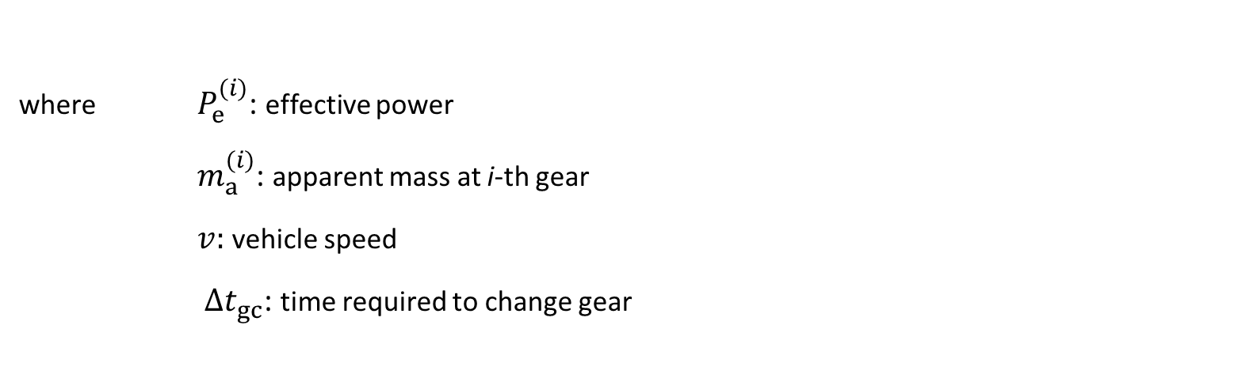
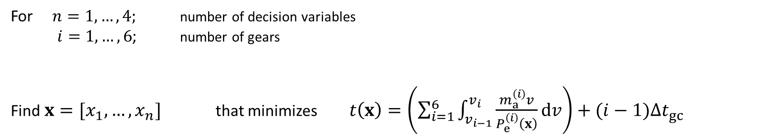
Problem Formulation
& Variables
For $n=1,…,4;$ number of decision variables
$i=1,…,6$; number of gears
Find $x=[x_{1},…,x_{n}]$ that minimizes $t\left(x\right)=\left(\sum_{i=1}^{6}{\int_{v_{i−1}}^{v_{i}}{\frac{m_{a}^{\left(i\right)}v}{P_{e}^{\left(i\right)}\left(x\right)}}dv}\right)+(i−1)∆t_{gc}$
where $P_{e}^{(i)}$: effective power
$m_{a}^{(i)}$: apparent mass at i-th gear
$v:$ vehicle speed
$∆t_{gc}$: time required to change gear

Slide 14
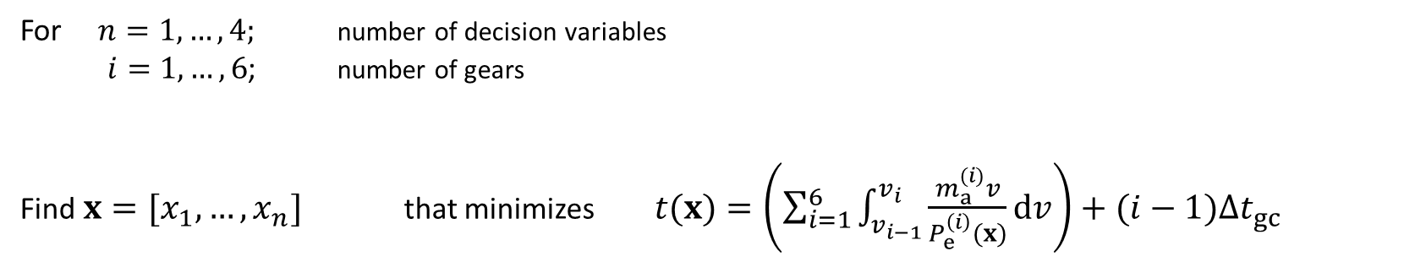
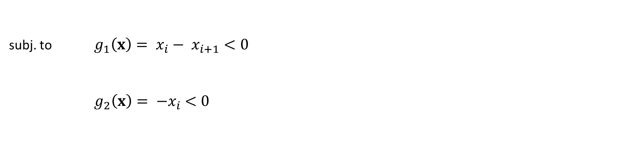
Problem Formulation
& Constraints
For $n=1,…,4;$ number of decision variables
$i=1,…,6$; number of gears
Find $x=[x_{1},…,x_{n}]$ that minimizes $t(x)=\left(\sum_{i=1}^{6}{\int_{v_{i−1}}^{v_{i}}{\frac{m_{a}^{(i)}v}{P_{e}^{\left(i\right)}(x)}}dv}\right)+(i−1)∆t_{gc}$
subj. to $g_{1}\left(x\right)= x_{i}− x_{i+1}<0$
$g_{2}\left(x\right)= {−x}_{i} <0$

Slide 15
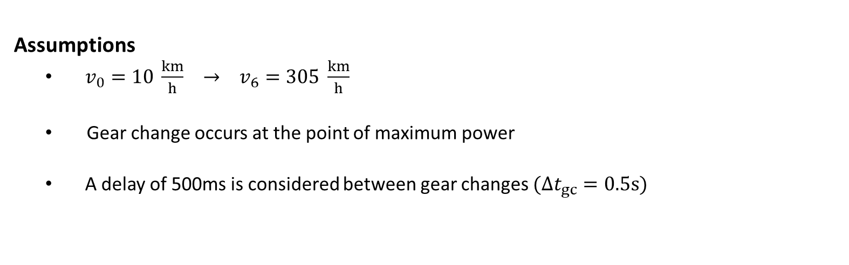
Problem Formulation
& Assumptions
For $n=1,…,4;$ number of decision variables
$i=1,…,6$; number of gears
Find $x=[x_{1},…,x_{n}]$ that minimizes $t\left(x\right)=\left(\sum_{i=1}^{6}{\int_{v_{i−1}}^{v_{i}}{\frac{m_{a}^{\left(i\right)}v}{P_{e}^{\left(i\right)}\left(x\right)}}dv}\right)+(i−1)∆t_{gc}$
Assumptions
$v_{0}=10 \frac{km}{h} → v_{6}=305 \frac{km}{h}$
Gear change occurs at the point of maximum power
A delay of 500ms is considered between gear changes $(∆t_{gc}=0.5s)$

Slide 16
Simulated Annealing
Overview

Slide 17
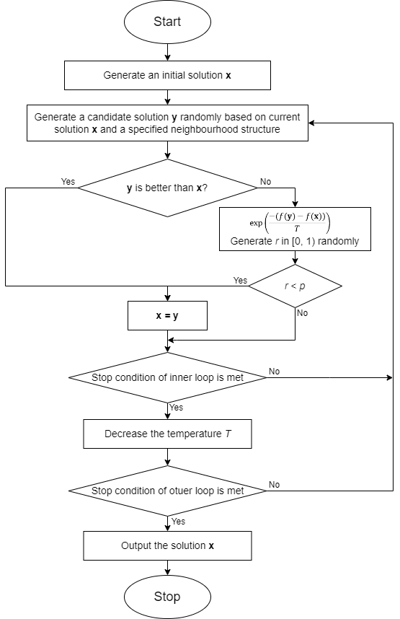
Simulated Annealing
Flow Chart
p =

Slide 18
Minimization of time to accelerate from an initial to an end velocity
Optimization Results
Francisco Stigliano & Edoardo Palmisciano
Notes:
RGB 0 85 114

Slide 19
Simulated Annealing
Settings
Parameter | Value
Initial Temperature | 50
Final Temperature | 0.01
Cooling Rate | 0.98
Maximum Iterations | 500
Starting Solution | [0.5, 0.5, 0.5, 0.5]

Slide 20

Reference Value
Factory Gear Ratios
F A C T O R Y G E A R R A T I O S
I | II | III | IV | V | VI
0.247 | 0.417 | 0.632 | 0.839 | 1.000 | 1.147
10 km/h $→$ 305 km/h
102.6 s

Slide 21
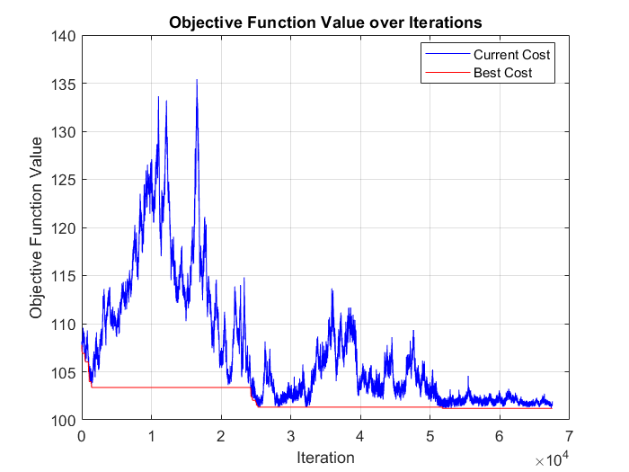
Simulated Annealing
Best Result
Best Run - Simulating Parameters
temperature = 50;
targetTemperature = 0.01;
coolingRate = 0.98;
maxIterations = 500 ;
currentSolution = [0.5, 0.5, 0.5, 0.5] ;
101.1 s
O P T I M A L G E A R R A T I O S
I | II | III | IV | V | VI
0.247 | 0.356 | 0.512 | 0.700 | 0.938 | 1.147

Slide 22
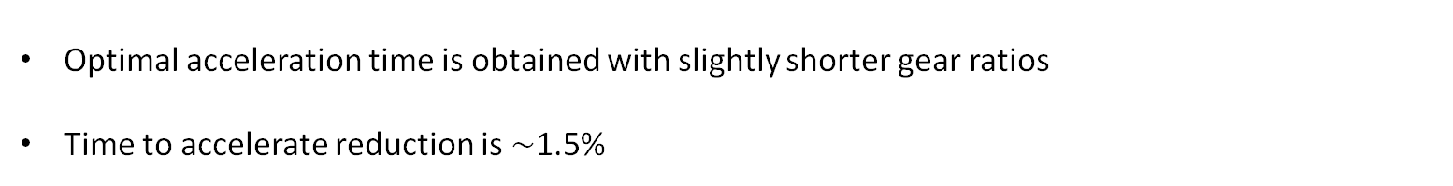
Conclusions
GEARS | I | II | III | IV | V | VI | Time
Factory | 0.247 | 0.417 | 0.632 | 0.839 | 1 | 1.147 | 102.6 s
Optimal | 0.247 | 0.356 | 0.512 | 0.7 | 0.938 | 1.147 | 101.1 s
Optimal acceleration time is obtained with slightly shorter gear ratios
Time to accelerate reduction is $\sim$1.5%
Bonus?

Slide 23
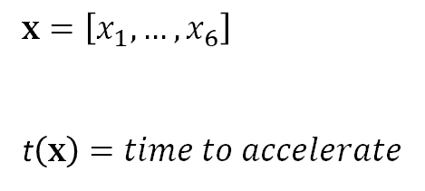
Optimization Problem
Definition
AT8 – 8 Speed Automatic
G E A R R A T I O S
I | II | III | IV | V | VI | VII | VIII
0.200 | ? | ? | ? | ? | ? | ? | 1.563
$$x$$
$$x=\left[x_{1},…,x_{6}\right]$$ t$\left(x\right)=time to accelerate$
Optimization Variables
Objective Function

Slide 24
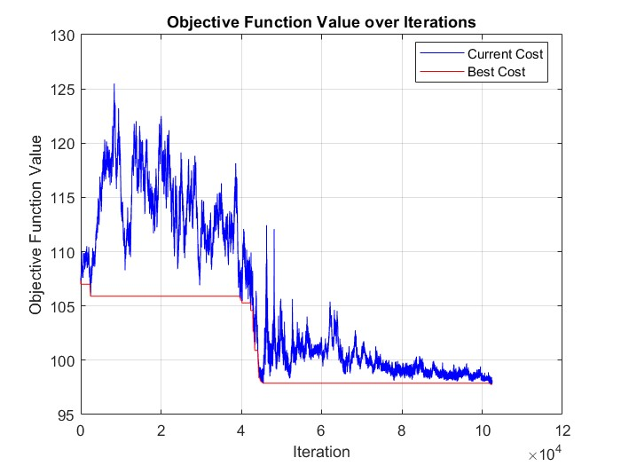
Conclusions
GEARS | I | II | III | IV | V | VI | VII | VIII | Time
Factory | 0.200 | 0.312 | 0.467 | 0.581 | 0.763 | 1.000 | 1.220 | 1.563 | 98.3 s
Optimal | 0.200 | 0.276 | 0.381 | 0.526 | 0.732 | 1.000 | 1.320 | 1.563 | 97.7 s
Best Run - Simulating Parameters
temperature = 70;
targetTemperature = 0.01;
coolingRate = 0.98;
maxIterations = 1000 ;
currentSolution = [0.5, 0.5, 0.5, 0.5, 0.5, 0.5] ;

Slide 25
Optimization of Cooling Tower Design for Minimized Return on Investment Time
Optimization Results
Francisco Stigliano & Edoardo Palmisciano

Slide 26
Simulated Annealing
Settings
Parameter | Value | Description
temperature | 150 | Initial "temperature" of the simulated annealing process
targetTemperature | 1 | Target "temperature" of the simulated annealing process
coolingRate | 0.99 | Cooling rate of the simulated annealing process
maxIterations | 5000 | Maximum number of iterations for the simulated annealing process

Slide 27
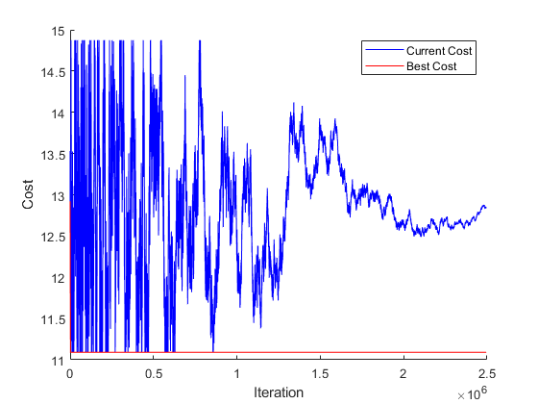
Minimizing Return on Investment Time
Optimization Results
Progression
Best solution: h = 100.00 m
Total investment: $287311259.62
ROI time: 11.09 years
Average for 5 Optimization Cicles

Slide 28
Minimizing Return on Investment Time
Results Discussion
Realistic?
Best solution: h = 100.00 m
Total investment: $287311259.62
ROI time: 11.09 years

Slide 29
Minimizing Return on Investment Time
Results Discussion
Realistic?
Unaccounted:
Time of construction
Years of investment until rewards
Best solution: h = 100.00 m
Total investment: $287311259.62
ROI time: 11.09 years

Slide 30

Minimizing Return on Investment Time
Results Discussion
Realistic?
Best solution: h = 100.00 m
Total investment: $287311259.62
ROI time: 11.09 years

Slide 31
Thank You
Francisco Stigliano & Edoardo Palmisciano

